Slide 2
solve problems based on simple interest computation,
analyze effect of change of principal, rate and time on simple interest.

Slide 3
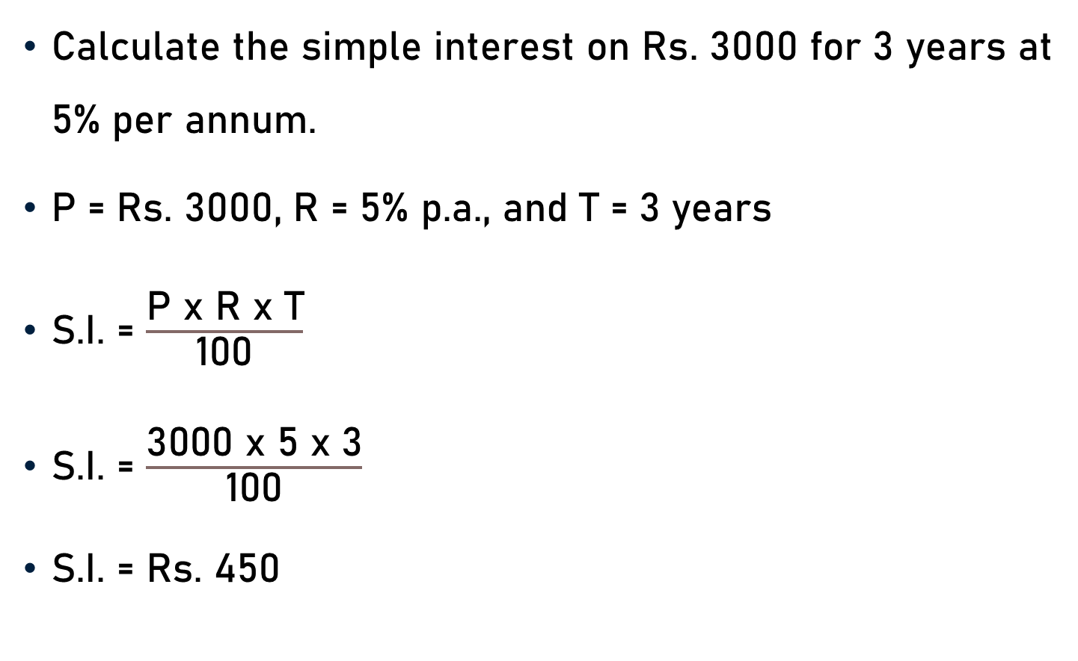
Problem 1
Calculate the simple interest on Rs. 3000 for 3 years at 5% per annum.
P = Rs. 3000, R = 5% p.a., and T = 3 years
S.I. = $\frac{\text{P} \text{x} \text{R} \text{x} \text{T}}{\text{100}}$
S.I. = $\frac{\text{3000} \text{x}\text{ 5 }\text{x}\text{ 3}}{\text{100}}$
S.I. = Rs. 450
30

Slide 4
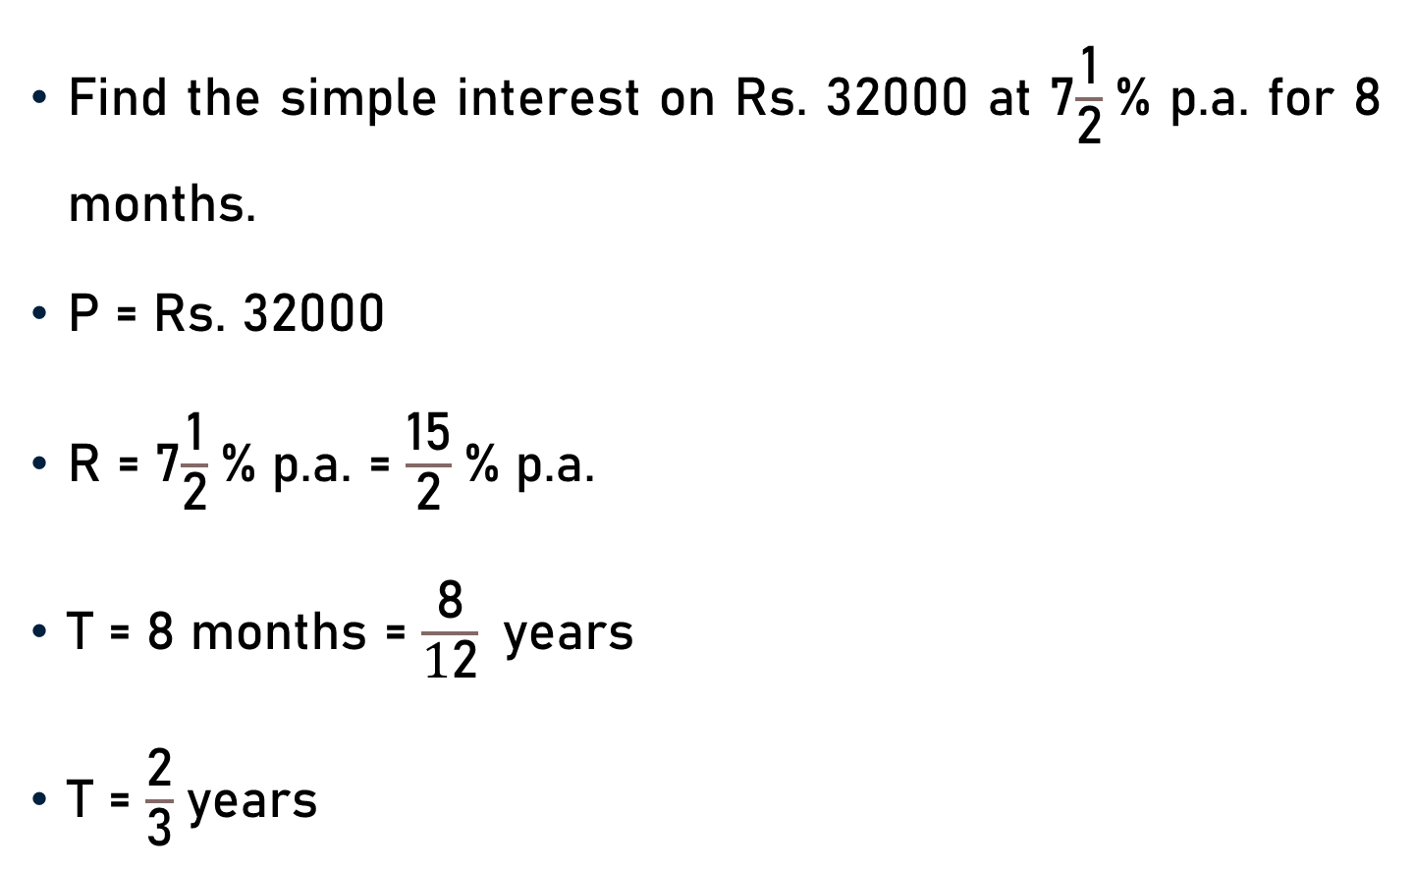
Problem 2
Find the simple interest on Rs. 32000 at 7$\frac{\text{1}}{\text{2}}$% p.a. for 8 months.
P = Rs. 32000
R = 7$\frac{\text{1}}{\text{2}}$% p.a. = $\frac{\text{1}\text{5}}{\text{2}}$% p.a.
T = 8 months = $\frac{\text{8}}{\text{1}\text{2}}$years
T = $\frac{\text{2}}{\text{3}}$years

Slide 5

Problem 2
P = Rs. 32000, R = $\frac{\text{15}}{\text{2}}$% p.a., & T = $\frac{\text{2}}{\text{3}}$years
S.I. = $\frac{\text{P} \text{x} \text{R} \text{x} \text{T}}{\text{100}}$
S.I. = $\frac{\text{3}\text{2}\text{000} \text{x} \text{1}\text{5 }\text{x} \text{2}}{\text{10}\text{0}\text{x} \text{2} \text{x}\text{ 3}}$
S.I. = Rs. 1600
320
5

Slide 6
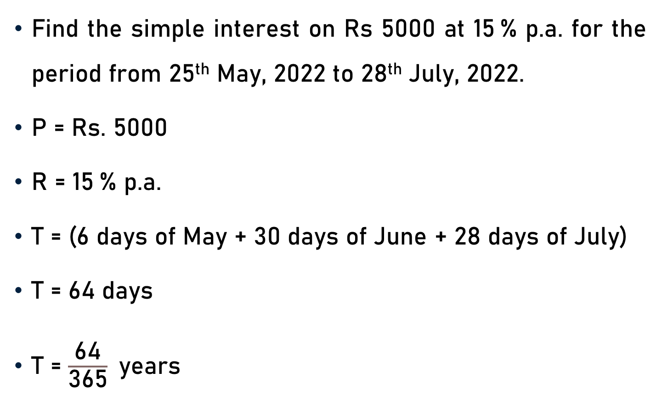
Problem 3
Find the simple interest on Rs 5000 at 15 % p.a. for the period from 25th May, 2022 to 28th July, 2022.
P = Rs. 5000
R = 15 % p.a.
T = (6 days of May + 30 days of June + 28 days of July)
T = 64 days
T = $\frac{\text{64}}{\text{365}}$years

Slide 7
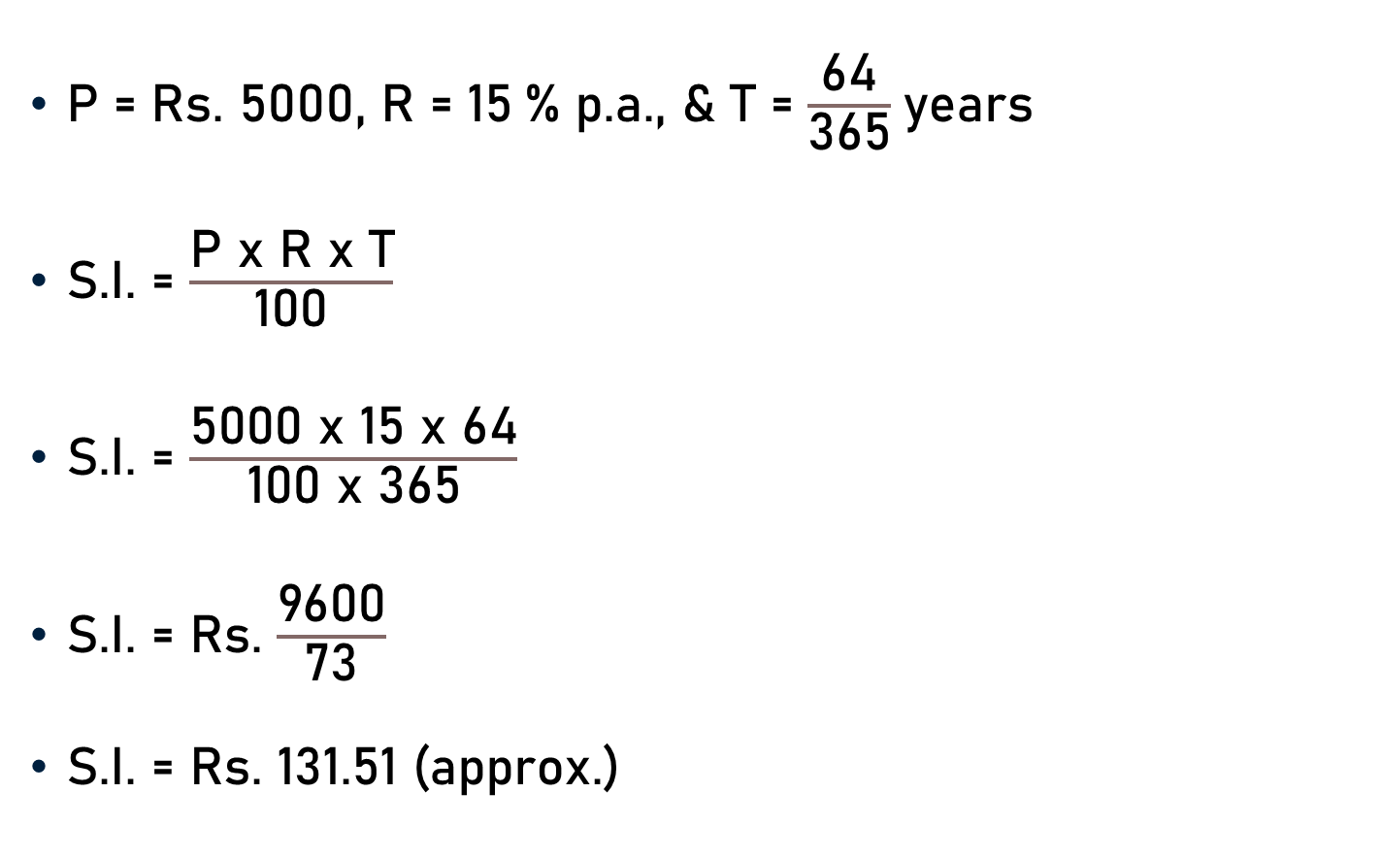
Problem 3
P = Rs. 5000, R = 15 % p.a., & T = $\frac{\text{64}}{\text{3}\text{65}}$years
S.I. = $\frac{\text{P} \text{x} \text{R} \text{x} \text{T}}{\text{100}}$
S.I. = $\frac{\text{5}\text{000} \text{x} \text{1}\text{5 }\text{x} \text{64}}{\text{10}\text{0} \text{x}\text{ 3}\text{65}}$
S.I. = Rs. $\frac{\text{9600}}{\text{73}}$
S.I. = Rs. 131.51 (approx.)
50
10
73

Slide 8
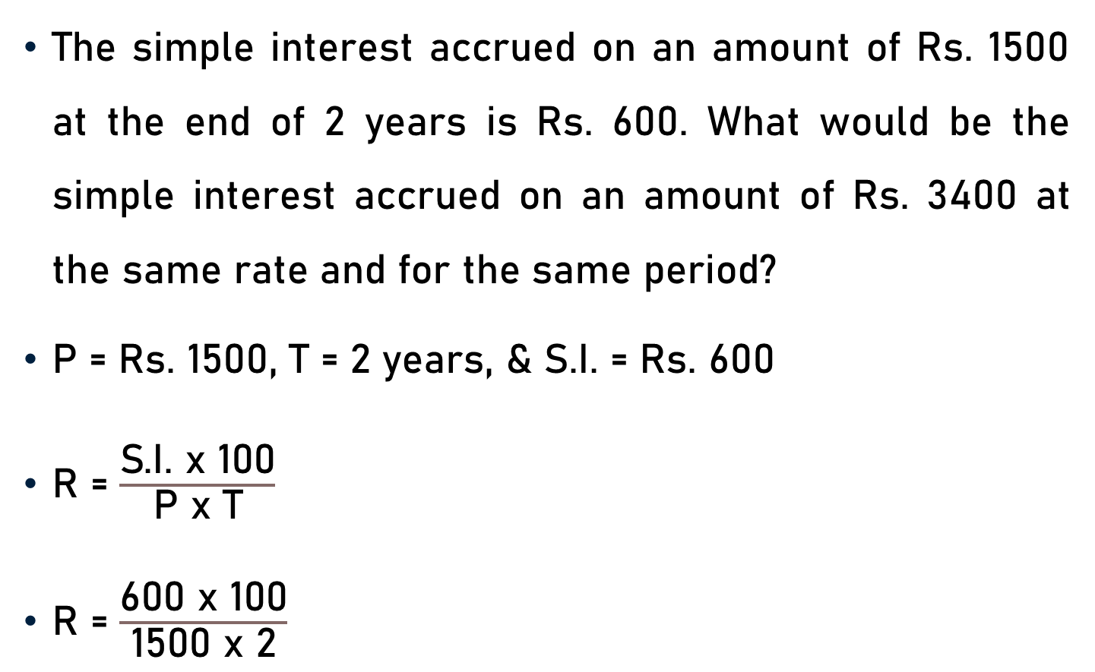
Problem 4
The simple interest accrued on an amount of Rs. 1500 at the end of 2 years is Rs. 600. What would be the simple interest accrued on an amount of Rs. 3400 at the same rate and for the same period?
P = Rs. 1500, T = 2 years, & S.I. = Rs. 600
R = $\frac{\text{S}\text{.}\text{I}\text{.} \text{x}\text{ 100}}{\text{P} \text{x} \text{T}}$
R = $\frac{\text{600 }\text{x}\text{ 100}}{\text{1500} \text{x}\text{ 2}}$

Slide 9

Problem 4
2
20
R = $\frac{\text{600 }\text{x}\text{ 100}}{\text{1500} \text{x}\text{ 2}}$
R = 20%
P = Rs. 3400, R = 20 % p.a., & T = 2 years
S.I. = $\frac{\text{P} \text{x} \text{R} \text{x} \text{T}}{\text{100}}$
S.I. = $\frac{\text{3400} \text{x} \text{20} \text{x} \text{2}}{\text{100}}$
S.I. = Rs. 1360
5

Slide 10

Effect of Change of P, R & T on S.I.
Change in Simple Interest (S.I.)= $\frac{\text{[}\text{Product} \text{of} \text{Fixed} \text{Parameter}\text{]×[}\text{Difference} \text{of} \text{Product} \text{of} \text{Variable} \text{Parameters}\text{]}}{\text{100}}$

Slide 11

Effect of Change of P on S.I.
If P changes but R & T remains same.
Change in S.I. = $\frac{\text{[}\text{R}\text{×}\text{T}\text{]} \text{x}\text{ [}\text{Change} \text{in} \text{P}\text{]}}{\text{100}}$

Slide 12
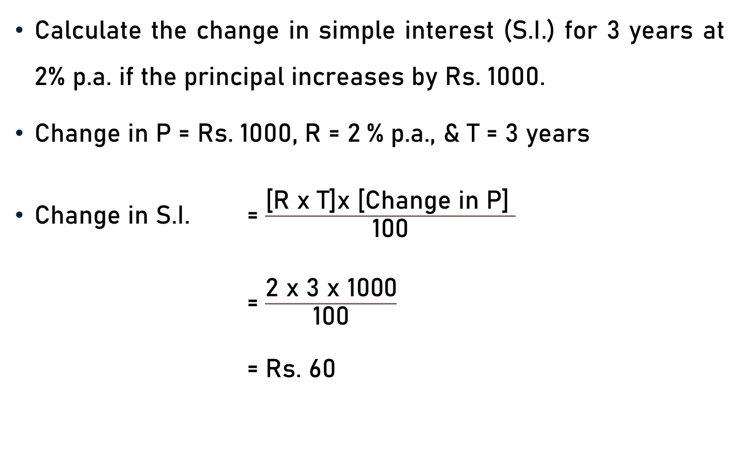
Problem 5
Calculate the change in simple interest (S.I.) for 3 years at 2% p.a. if the principal increases by Rs. 1000.
Change in P = Rs. 1000, R = 2 % p.a., & T = 3 years
Change in S.I. = $\frac{\text{[}\text{R} \text{x} \text{T}\text{]}\text{x}\text{ [}\text{Change} \text{in} \text{P}\text{]} }{\text{100}}$
= $\frac{\text{2 }\text{x} \text{3 }\text{x}\text{ 1000}}{\text{100}}$
= Rs. 60
10

Slide 13

Effect of Change of R on S.I.
If R changes but P & T remains same.
Change in S.I. = $\frac{\text{[}\text{P}\text{×}\text{T}\text{]}\text{x}\text{ [}\text{Change} \text{in} \text{R}\text{]}}{\text{100}}$

Slide 14
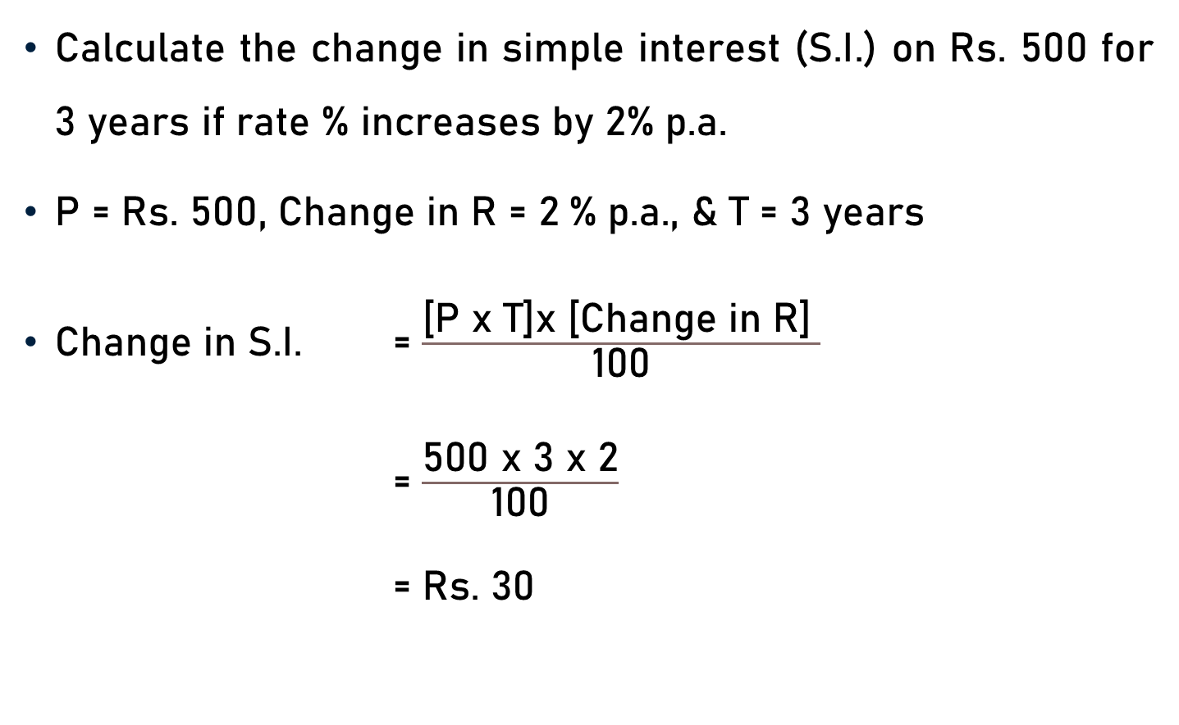
Problem 6
Calculate the change in simple interest (S.I.) on Rs. 500 for 3 years if rate % increases by 2% p.a.
P = Rs. 500, Change in R = 2 % p.a., & T = 3 years
Change in S.I. = $\frac{\text{[}\text{P} \text{x} \text{T}\text{]}\text{x}\text{ [}\text{Change} \text{in} \text{R}\text{]} }{\text{100}}$
= $\frac{\text{500 }\text{x} \text{3 }\text{x}\text{ 2}}{\text{100}}$
= Rs. 30
5

Slide 15

Effect of Change of T on S.I.
If T changes but P & R remains same.
Change in S.I. = $\frac{\text{[}\text{P}\text{×}\text{R}\text{]}\text{x}\text{ [}\text{Change} \text{in} \text{T}\text{]}}{\text{100}}$

Slide 16

Problem 7
Calculate the change in simple interest (S.I.) on Rs. 500 at 2% p.a. if the time increases by 6 years.
P = Rs. 500, R = 2 % p.a., & Change in T = 6 years
Change in S.I. = $\frac{\text{[}\text{P} \text{x} \text{R}\text{]}\text{x}\text{ [}\text{Change} \text{in} \text{T}\text{]} }{\text{100}}$
= $\frac{\text{500 }\text{x}\text{ 2} \text{x}\text{ 6}}{\text{100}}$
= Rs. 60
5

Slide 17

Effect of Change of R & T on S.I.
If R changes from ${\text{R}}_{1}$ to ${\text{R}}_{2}$, T changes from ${\text{T}}_{1}$ to ${\text{T}}_{2}$, and P is fixed.
Change in S.I. = $\frac{\text{P}\text{×}\text{ [}{\text{R}}_{1}{\text{T}}_{1}\text{−} {\text{R}}_{2}{\text{T}}_{2}\text{]}}{\text{100}}$

Slide 18
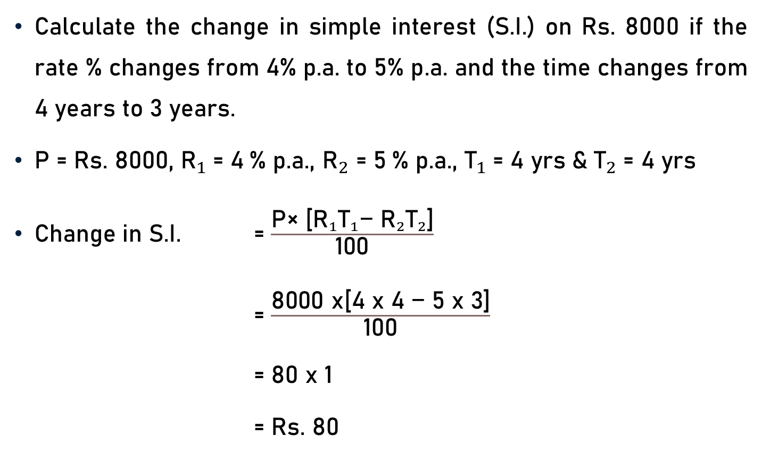
Problem 8
Calculate the change in simple interest (S.I.) on Rs. 8000 if the rate % changes from 4% p.a. to 5% p.a. and the time changes from 4 years to 3 years.
P = Rs. 8000, ${\text{R}}_{1}$= 4 % p.a., ${\text{R}}_{2}$ = 5 % p.a., ${\text{T}}_{1}$= 4 yrs ${\text{\&} \text{T}}_{2}$= 4 yrs
Change in S.I. = $\frac{\text{P}\text{× [}{\text{R}}_{1}{\text{T}}_{1}\text{−} {\text{R}}_{2}{\text{T}}_{2}\text{]}}{\text{100}}$
= $\frac{\text{8000} \text{x}\text{[}\text{4 }\text{x}\text{ 4 }\text{−}\text{ 5 }\text{x}\text{ 3]}}{\text{100}}$
= 80 x 1
= Rs. 80
80

Slide 19
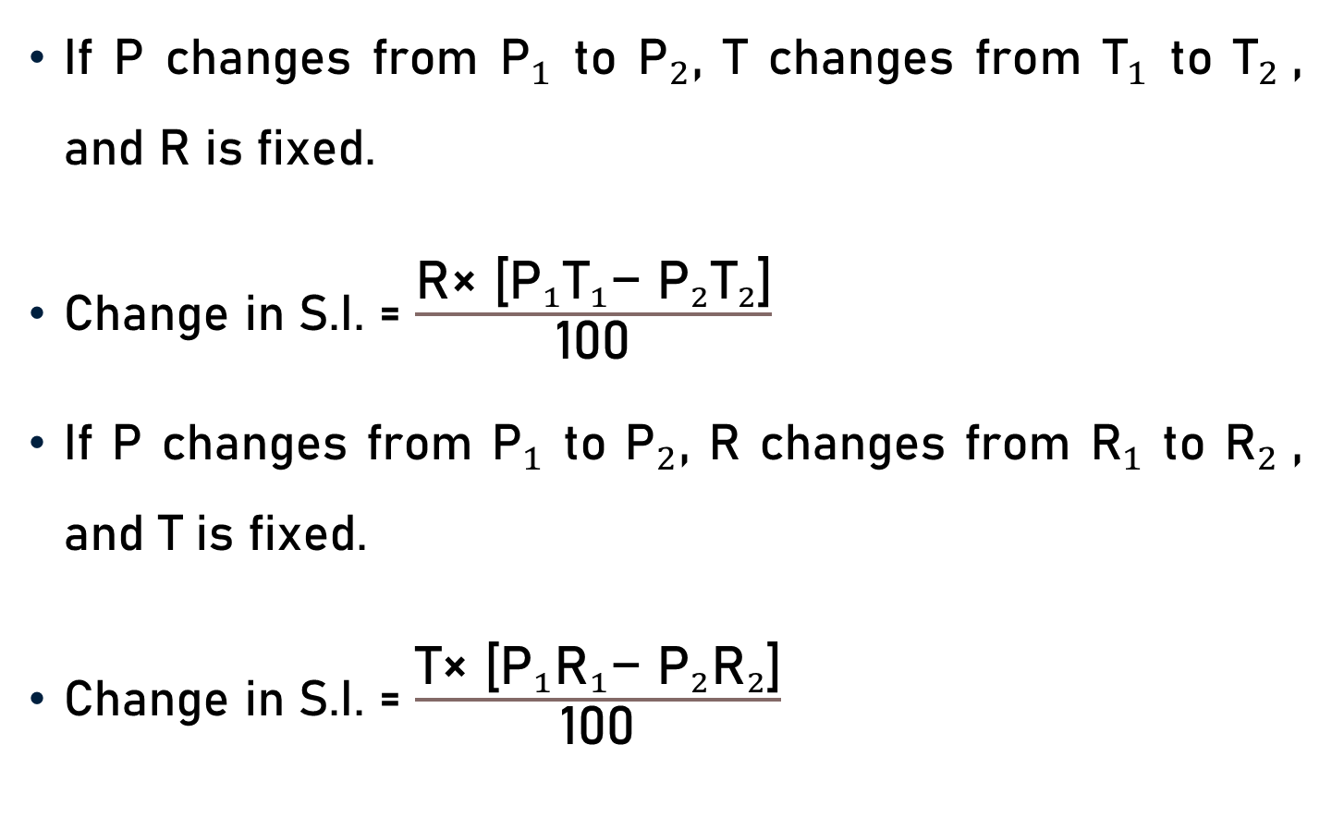
Effect of Change of P, R & T on S.I.
If P changes from ${\text{P}}_{1}$ to ${\text{P}}_{2}$, T changes from ${\text{T}}_{1}$ to ${\text{T}}_{2}$, and R is fixed.
Change in S.I. = $\frac{\text{R}\text{×}\text{ [}{\text{P}}_{1}{\text{T}}_{1}\text{−} {\text{P}}_{2}{\text{T}}_{2}\text{]}}{\text{100}}$
If P changes from ${\text{P}}_{1}$ to ${\text{P}}_{2}$, R changes from ${\text{R}}_{1}$ to ${\text{R}}_{2}$, and T is fixed.
Change in S.I. = $\frac{\text{T}\text{×}\text{ [}{\text{P}}_{1}{\text{R}}_{1}\text{−} {\text{P}}_{2}{\text{R}}_{2}\text{]}}{\text{100}}$

Slide 20

Conclusion
S.I. = $\frac{\text{P} \text{x} \text{R} \text{x} \text{T}}{\text{100}}$
Time
  Years
  Months
  Days
Effect of Change of P, R & T on S.I.

Slide 21
Summary
Simple Interest Computation
Principal, Rate & Time - Simple Interest

